Slide 1
You probably want to learn how to become a successful Influencer..

Slide 2
You probably want to be able to charge the amounts that the most successful influencers are charging..

Slide 3
Like..
$2000/Post
$8000/ Post
Even $200,000/Post

Slide 4
You may think that you can try your luck, create a profile, post some photos or videos, and wait for the brands to contact you for a sponsored post.

Slide 5
Well, it’s not that easy!

Slide 6
You need to follow the exact steps that other successful Influencers have followed.

Slide 7
You need to have a system in place.
You need to crack the Influencer Code!

Slide 8
Brands love social media Influencers because they encourage their followers to buy products they promote.

Slide 9
Based on recent marketing reports, the next three years will be the best years for Influencers!

Slide 10
There is no doubt that Influencer Marketing will be a MUST for many years to come.

Slide 11
On Instagram alone, Influencer Marketing is the top marketing strategy used by the biggest brands.

Slide 12
Major brands plan to increase spend on Influencer Marketing in the next years.

Slide 13
The Influencer Marketing industry is expected to hit $15bn by 2022.

Slide 14
Marketers spend $25,000-$50,000 on Influencer Marketing campaigns.

Slide 15
There is no better time than now to become a social media Influencer!

Slide 16
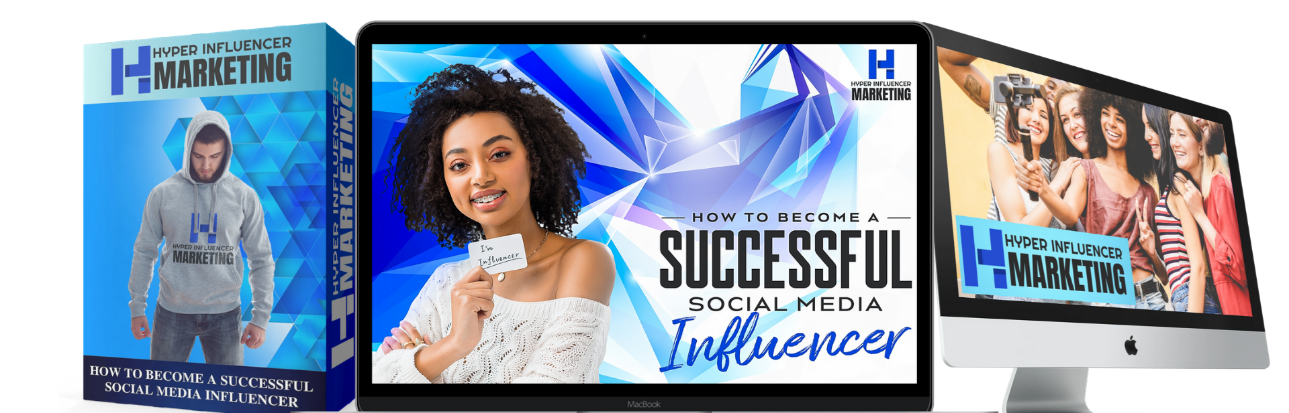
Introducing…

Slide 17
No surprises, no questions, no stones left unturned in this guide! You will learn all the secrets of the most successful social media Influencers!

Slide 18
Let's take a quick look at what you'll find inside.
How influencers generate their income.
How to go viral on TikTok.
How to use hashtags & challenges the right way on TikTok.
TikTok analytics! The best tool for an influencer.
What are the most important things when choosing your niche.
How to use captions and hashtags like a pro on Instagram.

Slide 19
Let's take a quick look at what you'll find inside.
Analyzing your audience and creating viral posts.
How to set yourself ready to be contacted by brands for promotions.
Things you should never do as an influencer.
How to set up your Youtube channel the right way.
Analyzing your channel data for maximum exposure.

Slide 20
Everything about TikTok, Instagram, and Youtube, step-by-step!

Slide 21
Here are the three easy steps to crush it as a social media influencer!
1. “Steal” our influencer marketing secrets
2. Implement all the steps in the guide
3. Collect the profits from your promotions

Slide 22

Act now and get free access to our exclusive fast action bonuses!
Fast Action Bonus #1 – Cheat Sheet ($27 Value)

Slide 23

Act now and get free access to our exclusive fast action bonuses!
Fast Action Bonus #2 – Mind Map ($17 Value)

Slide 24

Act now and get free access to our exclusive fast action bonuses!
Fast Action Bonus #3 – Resource Report ($17 Value)

Slide 25
We are 100% confident that you'll learn a fun way to become the next successful social media Influencer.

Slide 26
If for any reason you are not happy with what you got, send us an email and we will make sure to have your payment refunded.

Slide 27
No questions asked.

Slide 28

Click The Button Below Now To Get INSTANT ACCESS…

